Slide 1


Slide 2
COULMB,S LAW
Electric Charge, Electrical Conductors and Insulators

Slide 3
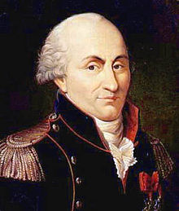
Introduction;
This law was given by CHARLESS COULOMB, a french military engineer in 1874 AD

Slide 4
(Electric Charge)
As we know that there are two kinds of charges:-
-Positive Charge
-Negative Charge
The charge on an electron assumed to be negative and charged on proton is positive.
Morever ,We also learnt that like charges repel each other and unlike charges attract
each other.

Slide 5
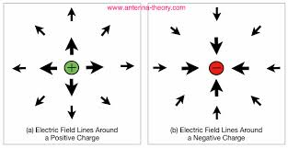
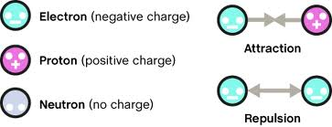

Slide 6
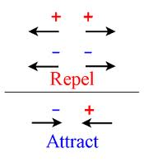
Diagram for attraction and repulsion.
Like Charges Repel.
Unlike charges Attract..
The SI derived unit of electric charge is the coulomb (C)

Slide 7
Electric force (F) direction according to charge type
q1/q2 charges | Force on q₁ charge | Force on q₂ charge
- / - | ←⊝ | ⊝→ | repletion
+ / + | ←⊕ | ⊕→ | repletion
- / + | ⊝→ | ←⊕ | attraction
+ / - | ⊕→ | ←⊝ | attraction

Slide 8
Conductors & Insulators
Electric Force: the force of attraction or repulsion between charged objects
Neutral: an object with no charge
-has an equal number of protons & electrons
5+
5-
0 (neutral)

Slide 9
Electric Charges
Electric charge is a basic property of matter
Two basic charges
Positive and Negative
Each having an absolute value of
1.6 x 10⁻¹⁹ Coulombs
Experiments have shown that
Like signed charges repel each other
Unlike signed charges attract each other
For an isolated system, the net charge of the system remains constant
Charge Conservation

Slide 10
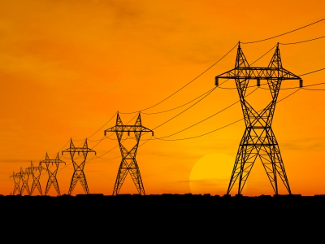
Two basics type of materials
Conductors
Materials, such as metals, that allow the free movement of charges
Insulators
Materials, such as rubber and glass, that don’t allow the free movement of charges

Slide 11
Electrical Conductors
Objects that allow electrical charge to flow easily

Slide 12
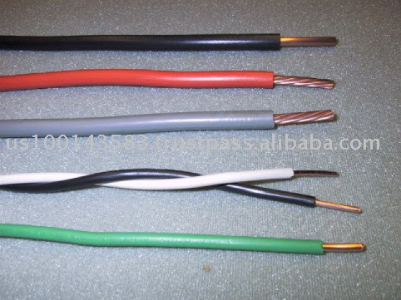
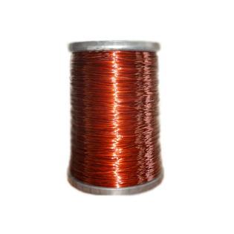
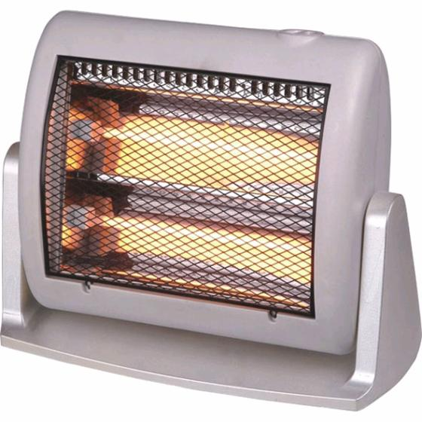
Electrical Conductor Example:
The coil from a electric heater gets hot and conducts electricity well

Slide 13
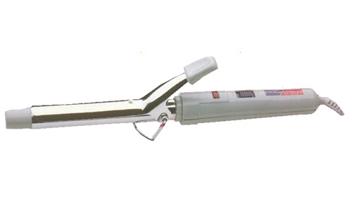
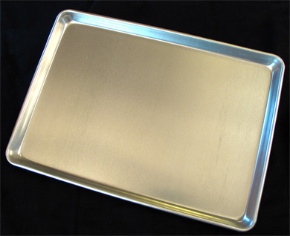
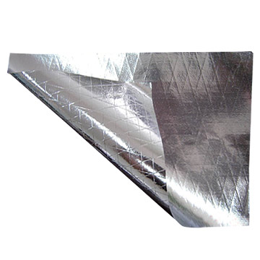
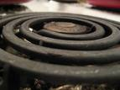
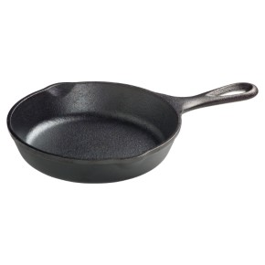
Good Conductors
Metal is a good conductor of electricity

Slide 14
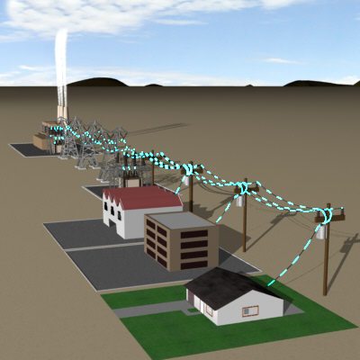
Property of Electrical Conductor:
In all good conductors electric current flows
through them without resistance
Example: Electricity flows through the coil in the power line coils without resistance and easily

Slide 15
Insulators
Objects that do not conduct electricity well

Slide 16
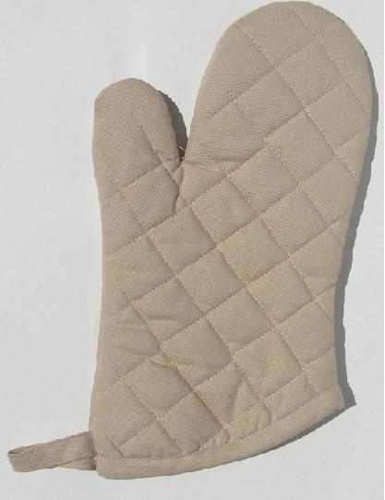
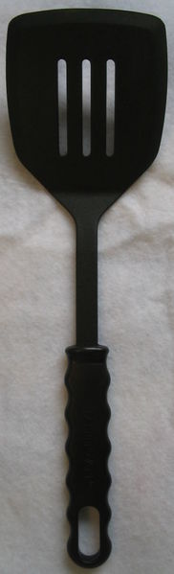
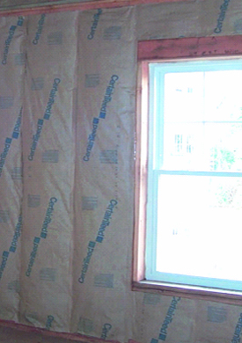
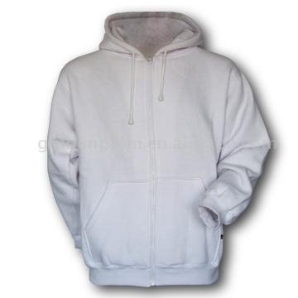
Good insulators:

Slide 17
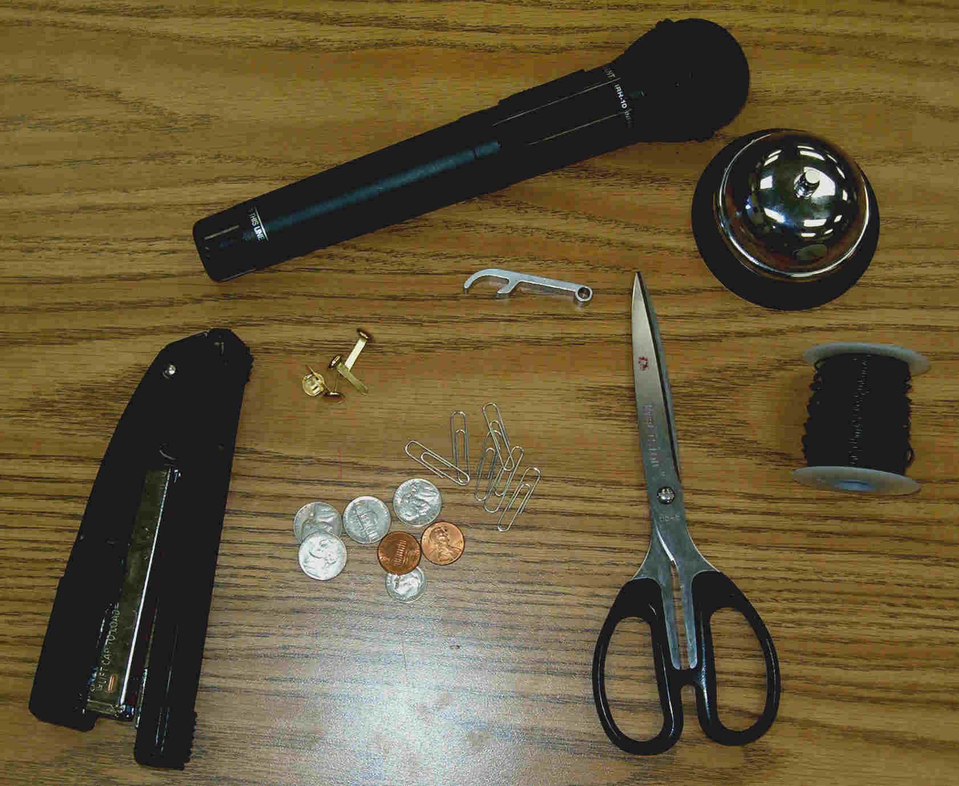
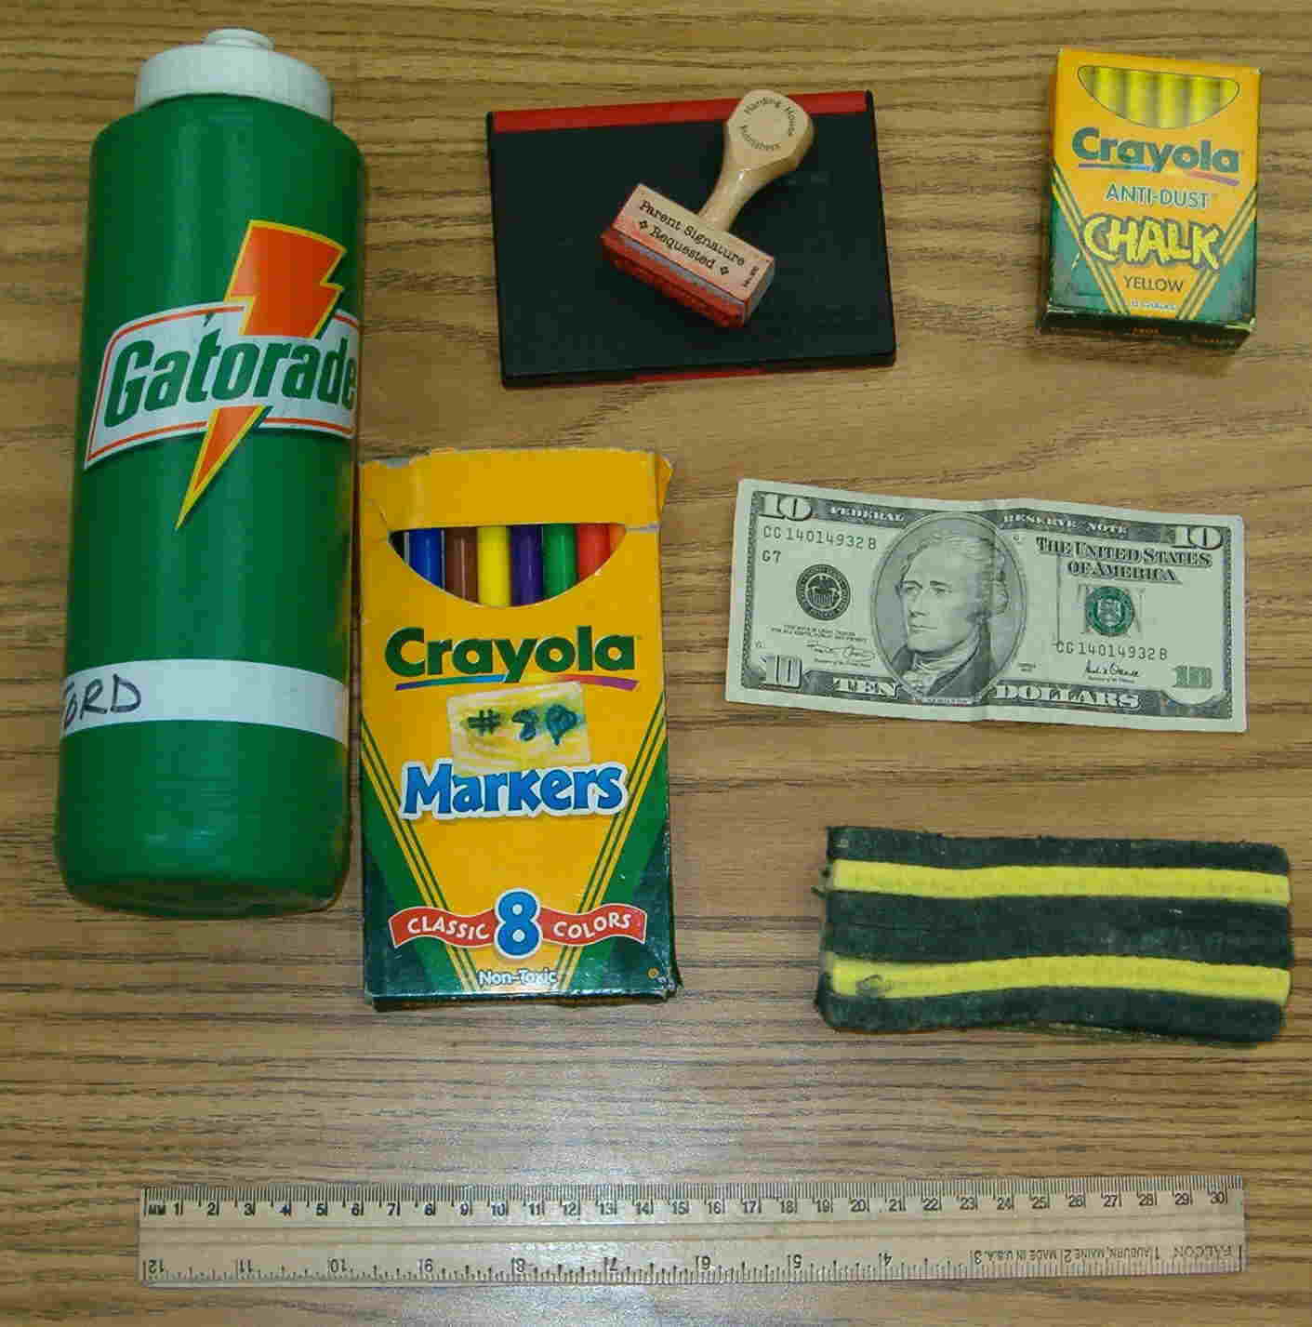
Pictures of conductors and Insulators
Conductors
Insulators

Slide 18
Insulator or Conductor??

Slide 19

1. Cotton ball

Slide 20
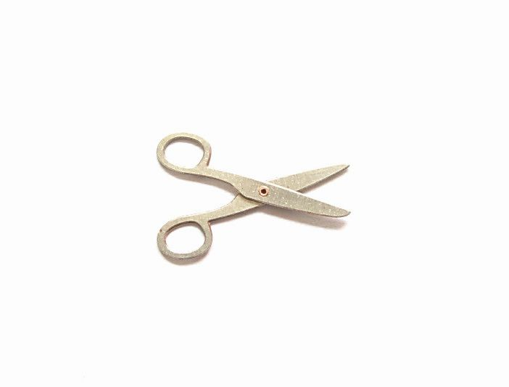
2. Metal scissors

Slide 21
3. Metal cookie sheet

Slide 22

4. Notebook paper

Slide 23
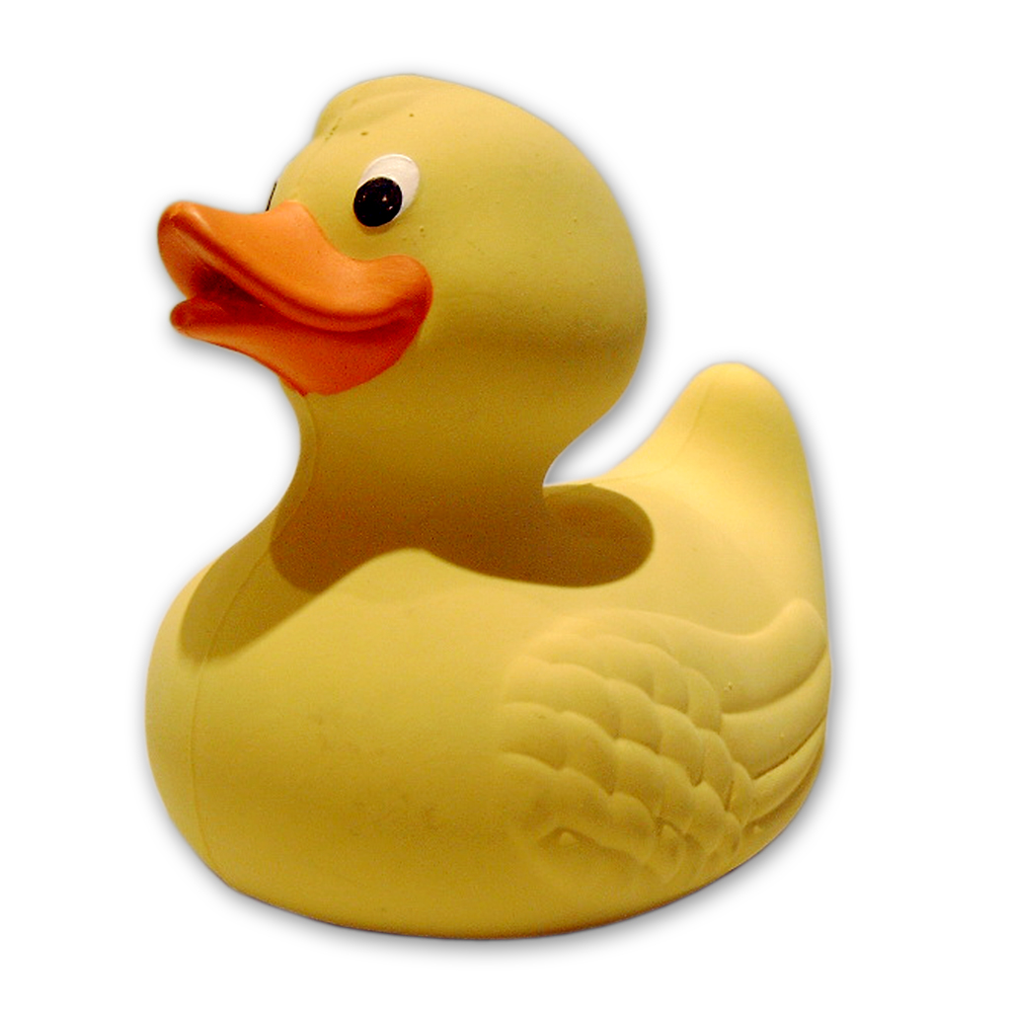
5. Rubber duck

Slide 24
6. Curling Iron

Slide 25
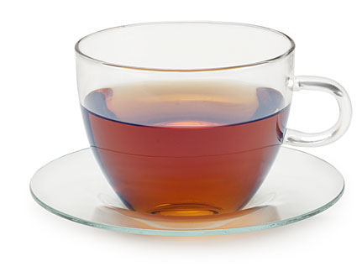
7. Glass Cup

Slide 26
8. Electric Heater (coils)

Slide 27
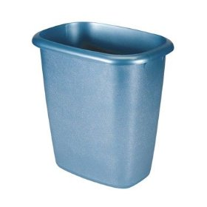
9. Plastic Trash Can

Slide 28
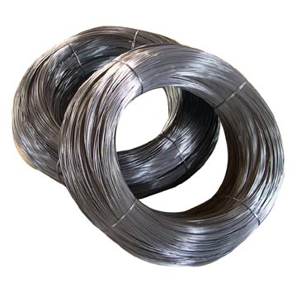
10. Metal Wire

Slide 29
11. Plastic Spatula

Slide 30
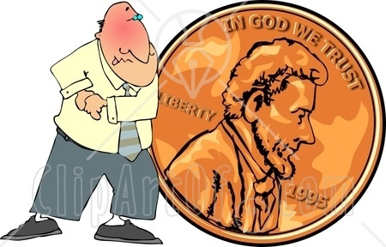
12. Copper Penny

Slide 31
13. Iron frying pan

Slide 32
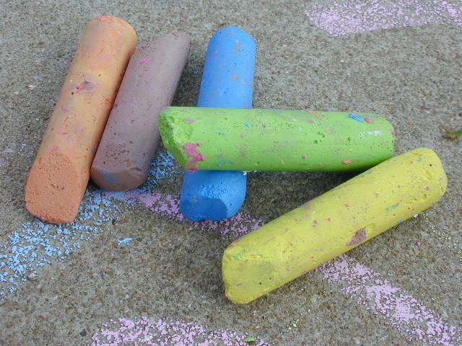
14. Drawing chalk

Slide 33
15. Eye on the stove

Slide 34
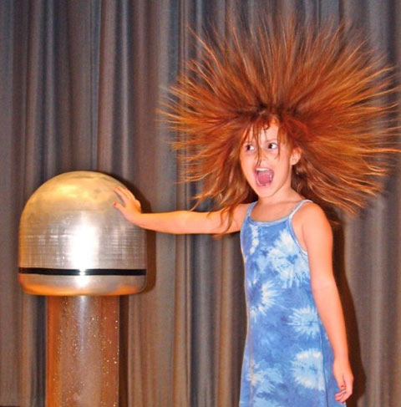
Conductors & Insulators
Static Electricity: an imbalance of electric charge at rest on the surface of an object

Slide 35
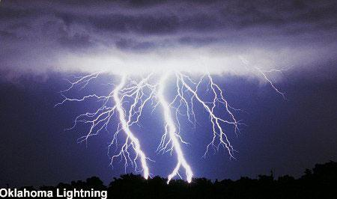
Conductors & Insulators
Electric Discharge: the rapid transfer of electrons from one object to another

Slide 36
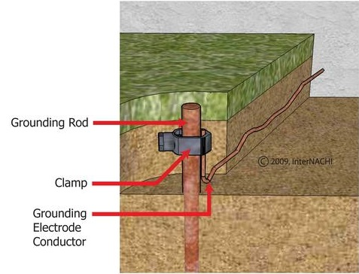
Conductors & Insulators
Electric Discharge: the rapid transfer of electrons from one object to another
Grounding: connecting an object to a large body, like Earth, that can remove an electric charge from the object

Slide 37
Electric Field
We say that when a charged object is put at a point in space,
The charged object sets up an Electric Field throughout the space surrounding the charged object
It is this field that then exerts a force on another charged object

Slide 38
Electric Field
Like the electric force,
the electric field is also a vector
If there is an electric force acting on an object having a charge q_{o}, then the electric field at that point is given by
(with the sign of q₀ included)

Slide 39
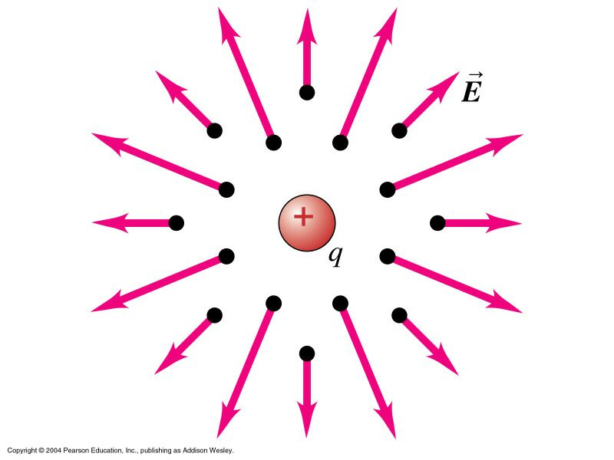
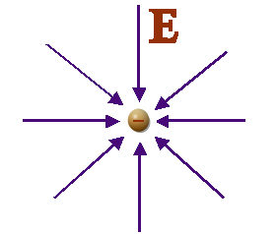
Electric Field
A positive charge sets up an electric field pointing away from the charge
A negative charge sets up an electric field pointing towards the charge

Slide 40
Electric Field Lines
At any given point, there can be only one field line
The electric field has a unique direction at any given point
Electric Field Lines
Begin on Positive Charges
End on Negative Charges

Slide 41
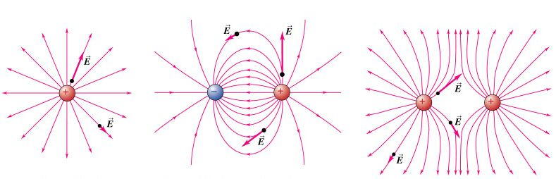
Electric Field Lines

Slide 42
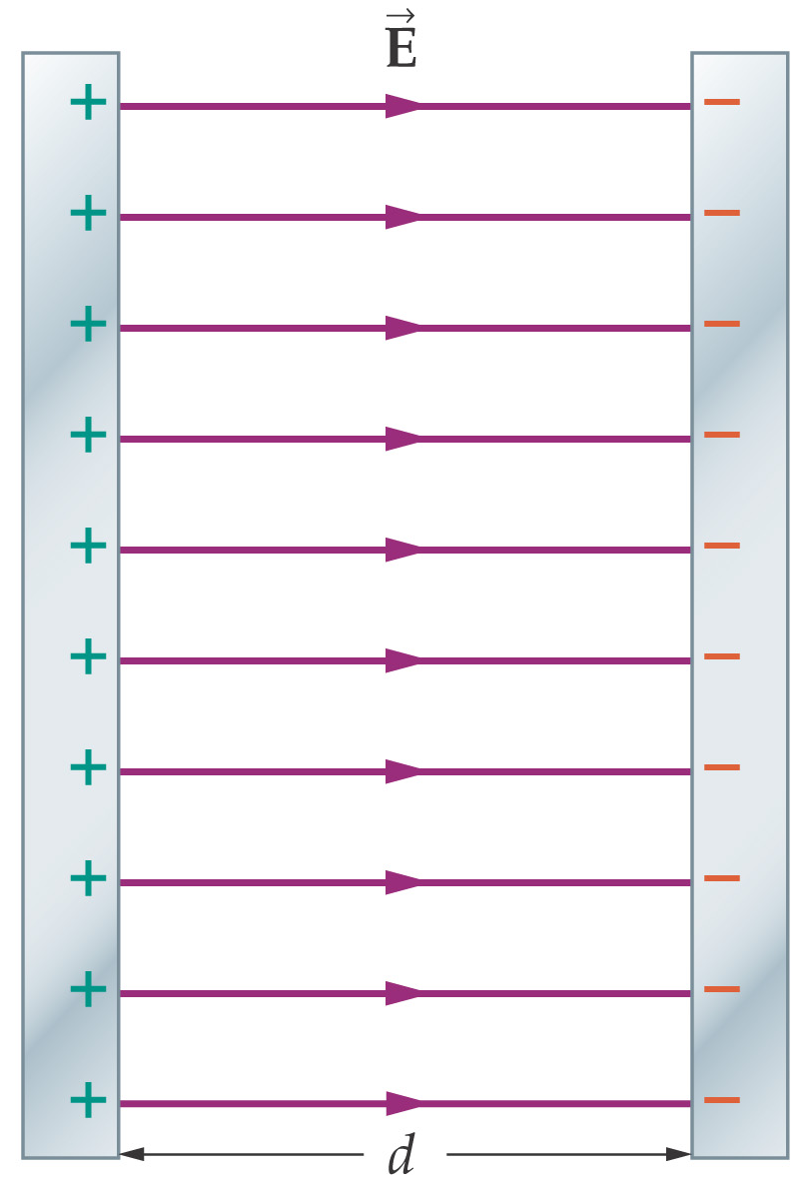
Electric Field Lines
A parallel-plate capacitor consists of two conducting plates with equal and opposite charges. Here is the electric field:

Slide 43
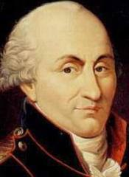
Introduction
The Measurement of the forces between the electric charges made in 1785 A.D (After Death Of Christ) By a French Engineer Named Charles Coulomb..
Due to these Measurements , he gave a law known as Coulomb’s Law …
(1736-1806)

Slide 44
STATEMENT;
The force between two point charges is directly proportional to the product of the magnitude of charges and inversely proportional to the square of the distance between them

Slide 45



Slide 46
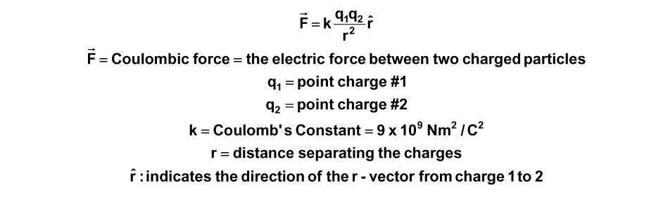

Slide 47
The value of k depends on;
The nature of the medium between the charges
The system of units in which F ,q ,r are measured

Slide 48
Effect of Medium on the Coulomb,s law

Slide 49
When medium between the charges is free space [vacuum]:
Case -1

Slide 50


єo=Permitivity of free space

Slide 51


Slide 52
Coulombs force in free space are

Slide 53
When medium between the charge is an insulator is called dielectric medium
case-2

Slide 54
In the presence of an dielectric medium the electrostatic force decrease by a factor єr єr =relative permittivity of the medium єr has different values for different materials

Slide 55
Values Of some things
Important Things in our Life | Relative Permitivity Value
Vacuum | 1
Ammonia | 22-25
3. Benzene | 2.284
4. Germanium | 16
5. Glass | 4.8-10
6. Rubber | 2.94
7. Water (Distilled) | 78.5

Slide 56
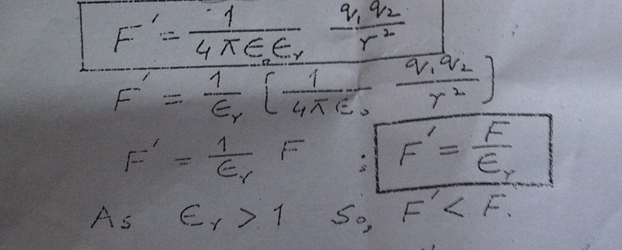

Slide 57
Coulomb Force Is a Mutual Force

Slide 58
f21
q2
r21
q2
q1
q1
F12 r12

Slide 59
If q1 exerts a force on q2 then q2 also exert a force on q1
These forces are equal in magnitude but opposite in direction
F21 =-F12

Slide 60
F21 = Force on charge q2 due to charge q1
F12 =Force on charge q1 due to charge q2
^
r21 =Unit vector directed from q1 to q2
^
r12 = unit vector directed from q2 to q1

Slide 61
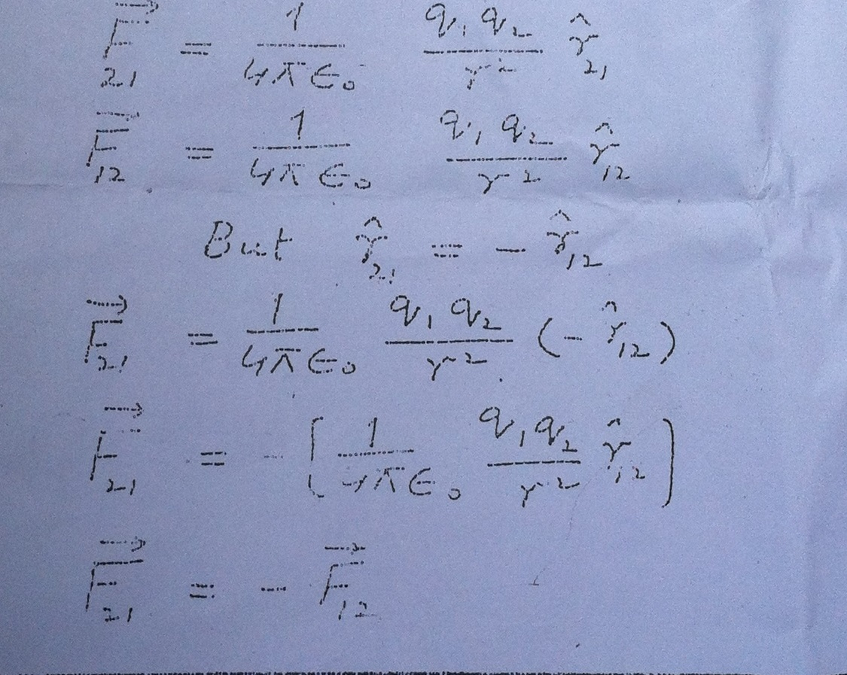

Slide 62
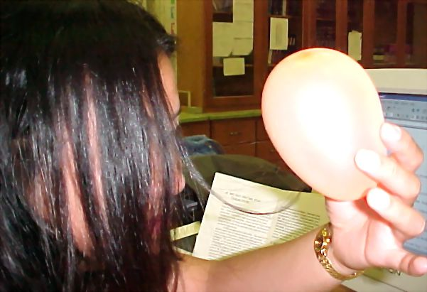
Examples Of Coulomb’s Law Attractive Forces (Examples)
If you rub a balloon on your hair, it will pick up some charge. The balloon has some extra charge, making it negative, while your hair has a positive charge ..

Slide 63
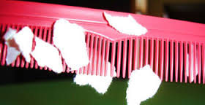
After a plastic comb is used for straightening dry hair (or rubbed on wool) it becomes electrically charged.

Slide 64
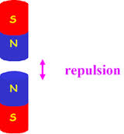
Repulsive Forces (Examples)
Like Poles Of a Magnet always repel each other..

Slide 65
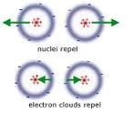
Nuclei repel and electron clouds repel…
Neutrons have same positive charges they repel each other and electrons have negative charges so they also repel each other…

Slide 66
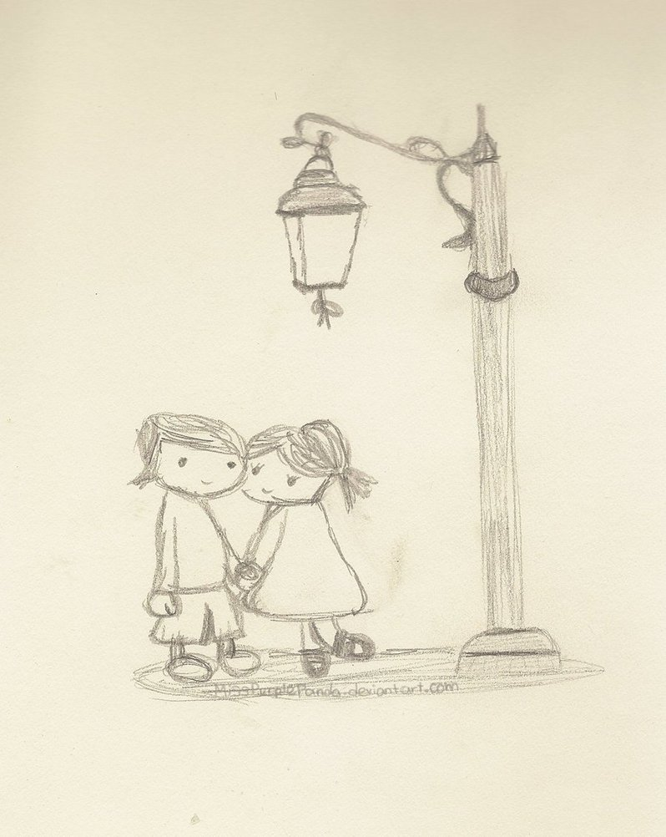
But It Doesn’t Means that the attraction between boy and girl follows Coulomb’s law.. It’s A Natural law!

